Slide 1
Do not delete this slide.
This slide is designed so that you can copy the prompt box you need and insert it into your slides.
This slide is hidden and will not be included when presenting your lesson.
TRACK WITH ME
VOCABULARY
1 -
HINT
Students, remember….
CHECK FOR UNDERSTANDING
READ WITH ME
TEACHER CUE
MAKE THE CONNECTION
Students, you already know….
EXTENSION
GESTURE WITH ME

Slide 2
Sex-Linked Traits Review
PLICKERS

Slide 3
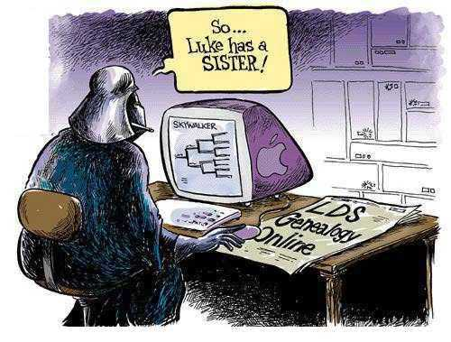
Pedigrees
We will use pedigrees to demonstrate and predict inheritance of traits in offspring
Notes:
Insert cover image and use transparency settings to fade image.

Slide 4
We will use pedigrees to demonstrate and predict inheritance of traits in offspring
TRACK WITH ME
READ WITH ME
Explain what a pedigree shows.
Interpret symbols used in pedigrees to show inheritance of traits.
Use pedigrees to demonstrate inheritance and predict inheritance of traits in offspring.
Notes:
Learning Objectives contain concepts (nouns, big ideas), skills (verbs, measurable behaviours) and sometimes context (restricting or targeting conditions).
●Example: Students will be able to describe the concept of density and apply it to floating and sinking.
●
Success criteria are specific measurable outcomes that if met mean that the student has met the learning objective.
Examples:
•Students will be able to compare densities of substances using mass and volume.
•Students will be able to identify whether a solid or liquid will float or sink in a liquid based on their densities.

Slide 5
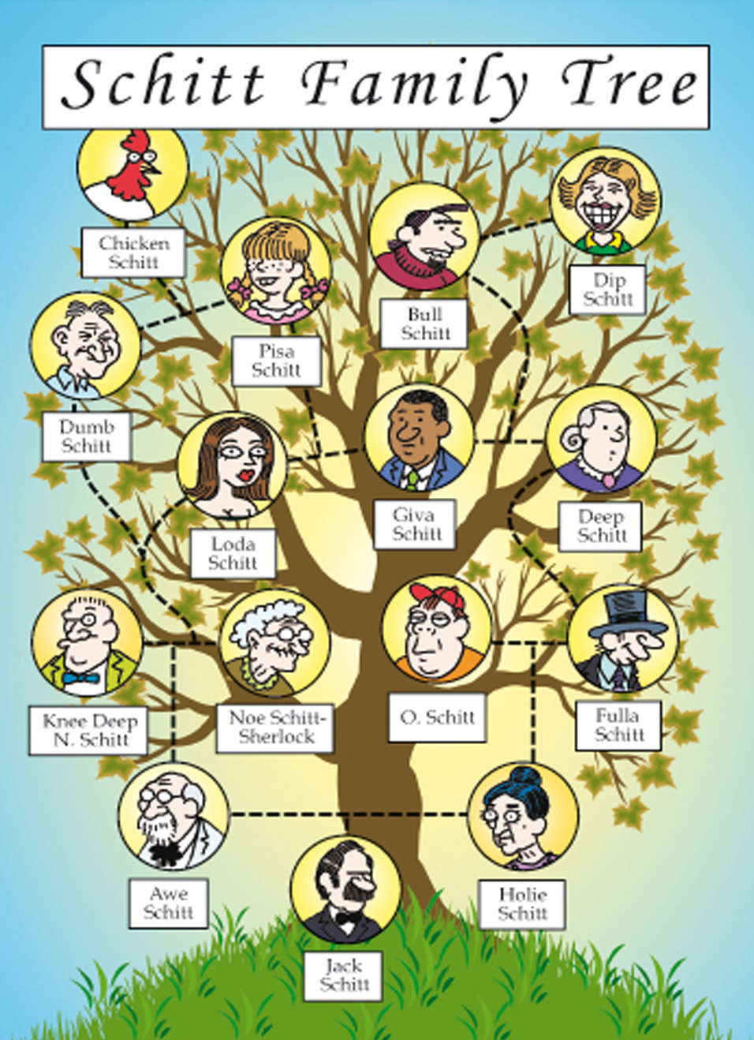
We will use pedigrees to demonstrate and predict inheritance of traits in offspring
Pronounced ‘zit’
Pedigrees are diagrams used to show how individuals are related to one another.
They track how alleles are passed from parents to offspring across many generations.
Pedigrees are similar to family trees.

Slide 6
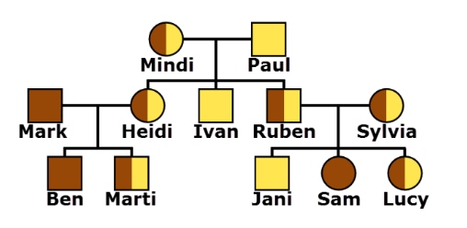
CHECK FOR UNDERSTANDING
Parents/Children – Random questioning!
We will use pedigrees to demonstrate and predict inheritance of traits in offspring
Circle = woman
Square = man
Colours = genotype
Remember, an individual’s genotype is determined by the alleles they possess! (RR, Rr, rr)
Think-Pair-Share
Predict which colour is dominant? Why?

Slide 7
We will predict the outcome of sex-linked trait inheritance using Punnett squares
Recessive allele (b) codes for blonde hair.
Dominant allele (B) codes for brown hair.
Think-Pair-Share
Predict which colour is dominant? Why? Punnett squares can help!

Slide 8
We will use pedigrees to demonstrate and predict inheritance of traits in offspring
Heidi has the genotype Bb. Determine which allele came from her father and which came from her mother.
Hint: use a Punnett square to get your answer!
Remember blonde is recessive (b) and brown is dominant (B)
Paul is Heidi’s father. He has the genotype bb so can only pass on an allele for blond hair. Heidi must have received her blond allele from him! Her brown allele must have therefore came from her mother.

Slide 9
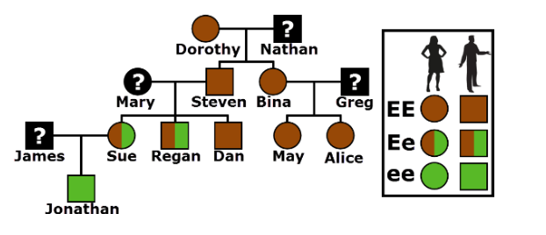
We will use pedigrees to demonstrate and predict inheritance of traits in offspring
Pedigrees can also be used to try and figure out missing genotypes.
Four Three Corners
What do you think Nathan’s genotype could be? EE Ee ee

Slide 10
We will use pedigrees to demonstrate and predict inheritance of traits in offspring
Pedigrees can also be used to try and figure out missing genotypes.
Four Three Corners
It could be either EE or Ee!

Slide 11


We will use pedigrees to demonstrate and predict inheritance of traits in offspring
Your number is important to me!
Rapid 5
Exit Ticket

Slide 12
We will use pedigrees to demonstrate and predict inheritance of traits in offspring
TRACK WITH ME
READ WITH ME
Explain what a pedigree shows.
Interpret symbols used in pedigrees to show inheritance of traits.
Use pedigrees to demonstrate inheritance and predict inheritance of traits in offspring.
Notes:
Learning Objectives contain concepts (nouns, big ideas), skills (verbs, measurable behaviours) and sometimes context (restricting or targeting conditions).
●Example: Students will be able to describe the concept of density and apply it to floating and sinking.
●
Success criteria are specific measurable outcomes that if met mean that the student has met the learning objective.
Examples:
•Students will be able to compare densities of substances using mass and volume.
•Students will be able to identify whether a solid or liquid will float or sink in a liquid based on their densities.

